Slide 1
Neural Network for cost estimation: Hyperparameter tuning

Slide 2
Overview
Problem setting + motivation (2-3)
Methodology
Process overview (1)
Optimization problem (2)
Neural network (2)
Line benefits (1)
Clustering process (1)
Results thus far
Neural network output (6)
Line benefits (2)
Future tasks (1)

Slide 3
Process overview
Benchmark:
Full time horizon
Input Data
ESOM
Traditional:
Split time horizon
Input Time Series
Clustering
Method
Representative Time Series
ESOM
Relaxed ESOM
Features
Clustering
Method
Representative Time Series
ESOM
Based in Costs:
Split time horizon
(ANN + Kmedoids)
Clustering
Method
Investment Benefit
Proposal:
Split time horizon
ANN: Cost Estimator
Features
(Investment benefit)
Representative Time Series
ESOM
*ESOM: Energy System Optimization Model
**ANN: Artificial Neural Network

Slide 4
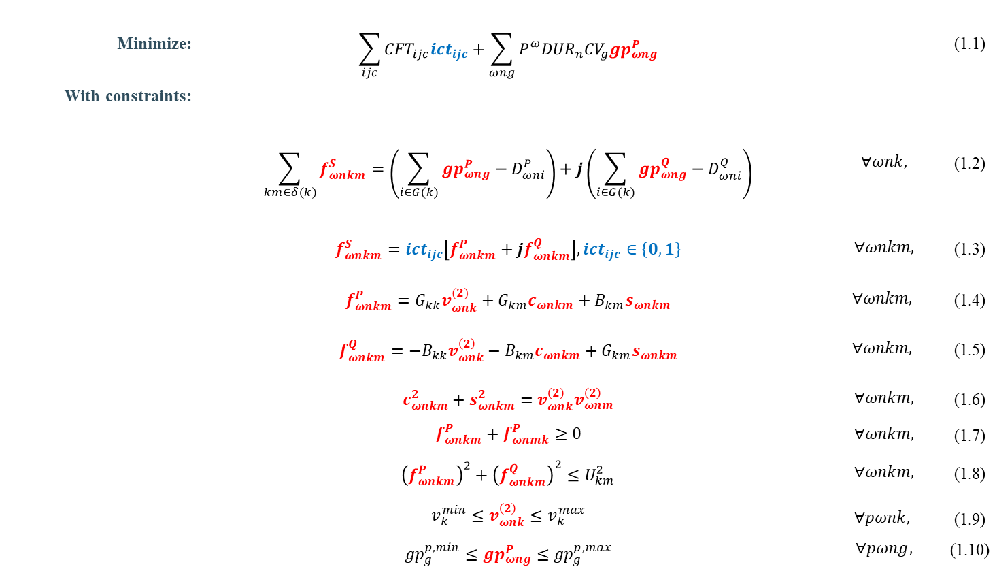
ESOM: Transmission Expansion Planning considering AC-OPF
Minimize: | $$\sum_{ijc}{{CFT}_{ijc}{ict}_{ijc}}+\sum_{ωng}{P_{}^{ω}{DUR}_{n}{CV}_{g}{gp}_{ωng}^{P}}$$ |  | (1.1)
With constraints:
 | $$\sum_{km∈δ(k)}{f_{ωnkm}^{S}}=\left(\sum_{i∈G(k)}{{gp}_{ωng}^{P}−D_{ωni}^{P}}\right)+j\left(\sum_{i∈G(k)}{{gp}_{ωng}^{Q}−D_{ωni}^{Q}}\right)$$ | $$∀ωnk,$$ | (1.2)
 | $$f_{ωnkm}^{S}={ict}_{ijc}\left[f_{ωnkm}^{P}+jf_{ωnkm}^{Q}\right],{ict}_{ijc}∈\left\{0,1\right\}$$ | $$∀ωnkm,$$ | (1.3)
 | $$f_{ωnkm}^{P}=G_{kk}v_{ωnk}^{(2)}+G_{km}c_{ωnkm}+B_{km}s_{ωnkm}$$ | $$∀ωnkm,$$ | (1.4)
 | $$f_{ωnkm}^{Q}=−B_{kk}v_{ωnk}^{\left(2\right)}−B_{km}c_{ωnkm}+G_{km}s_{ωnkm}$$ | $$∀ωnkm,$$ | (1.5)
 | $$c_{ωnkm}^{2}+s_{ωnkm}^{2}=v_{ωnk}^{\left(2\right)}v_{ωnm}^{\left(2\right)}$$ | $$∀ωnkm,$$ | (1.6)
 | $$f_{ωnkm}^{P}+f_{ωnmk}^{P}≥0$$ | $$∀ωnkm,$$ | (1.7)
 | $${\left(f_{ωnkm}^{P}\right)}^{2}+{\left(f_{ωnkm}^{Q}\right)}^{2}≤U_{km}^{2}$$ | $$∀ωnkm,$$ | (1.8)
 | $$v_{k}^{min}≤v_{ωnk}^{\left(2\right)}≤v_{k}^{max}$$ $${gp}_{g}^{p,min}≤{gp}_{ωng}^{P}≤{gp}_{g}^{p,max}$$ | $$∀pωnk,$$ $$∀pωng,$$ | (1.9) (1.10)
Non-convex
Getting a MILP model by applying:
Disjunctive constraints
Piecewise functions
McCormick envelopes

Slide 5
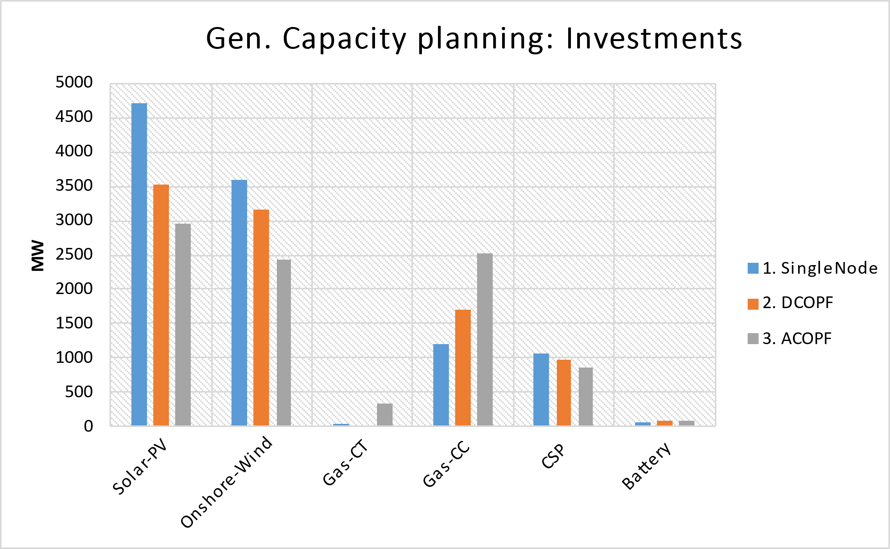
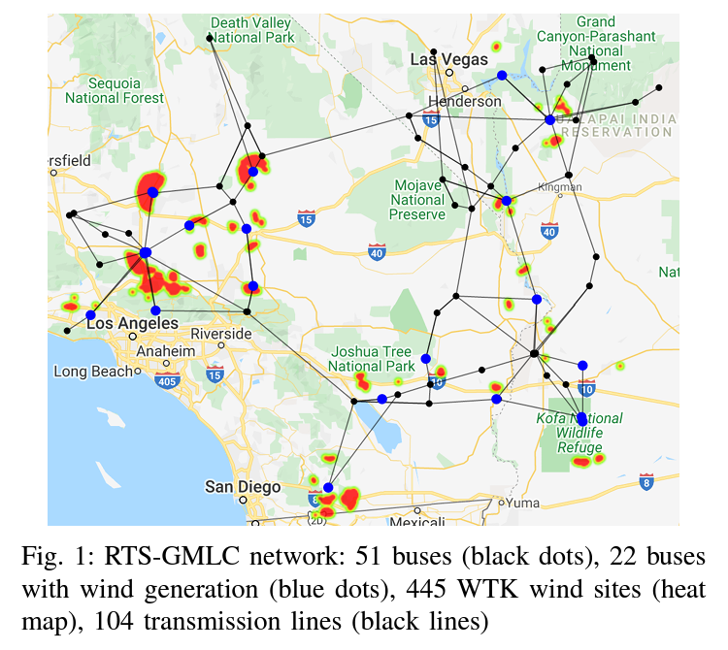
ESOM: Why considering AC-OPF?
Disadvantages:
ACOPF’s problem size is ~4x-6x of the DCOPF
Computation burden: ~6x-10x
Implications on the Gen. capacity planning
Implications on the transmission expansion
RTS-GMLC
Source: Scenario Creation and Power Conditioning Strategies for
Operating Power Grids with Two-Stage Stochastic Economic Dispatch
Link: https://www.nrel.gov/docs/fy21osti/75363.pdf

Slide 6
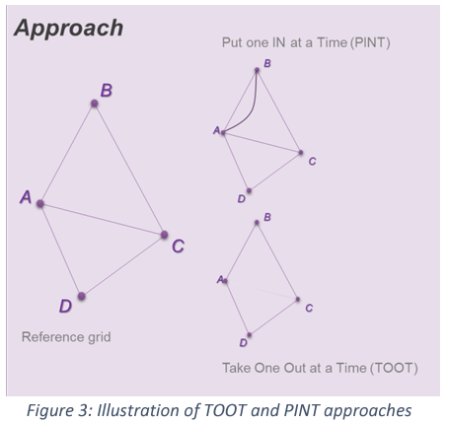
Line Benefits
The PINT and TOOT
Investment Benefit
ANN: Cost Estimator
Sequence per candidate asset and hour
PINT (or TOOT)
Reference grid
ANN Cost
Estimator
ANN Cost
Estimator
Line Benefit Methods:
The Put IN one at the Time (PINT)
The Take Out One at the Time (TOOT)
Shapley value
Aumann-shapley value
Benefit 1 (Benefit 2) =
Reference grid – PINT
(TOOT – Reference grid)
[source] ENTSO-E: Guideline for Cost Benefit Analysis of Grid Development Projects
Link: https://eepublicdownloads.entsoe.eu/clean-documents/tyndp-documents/Cost%20Benefit%20Analysis/191023_CBA3_Draft%20for%20consultation.pdf

Slide 7
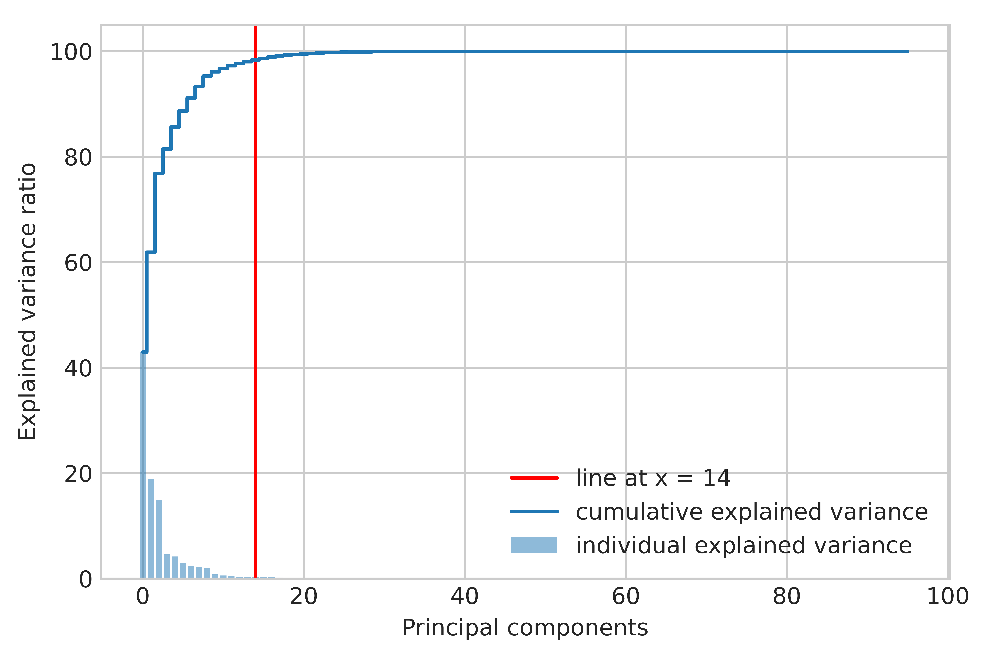
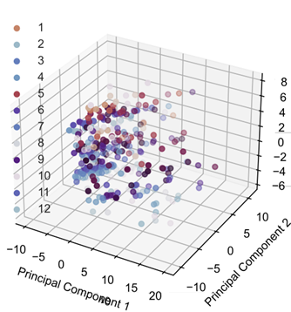
Clustering process
Dimensionality reduction
Optimal number of representatives/clusters
Selection/aggregation using K-medoids
Dimensionality reduction using PCA
Optimal number of clusters

Slide 8
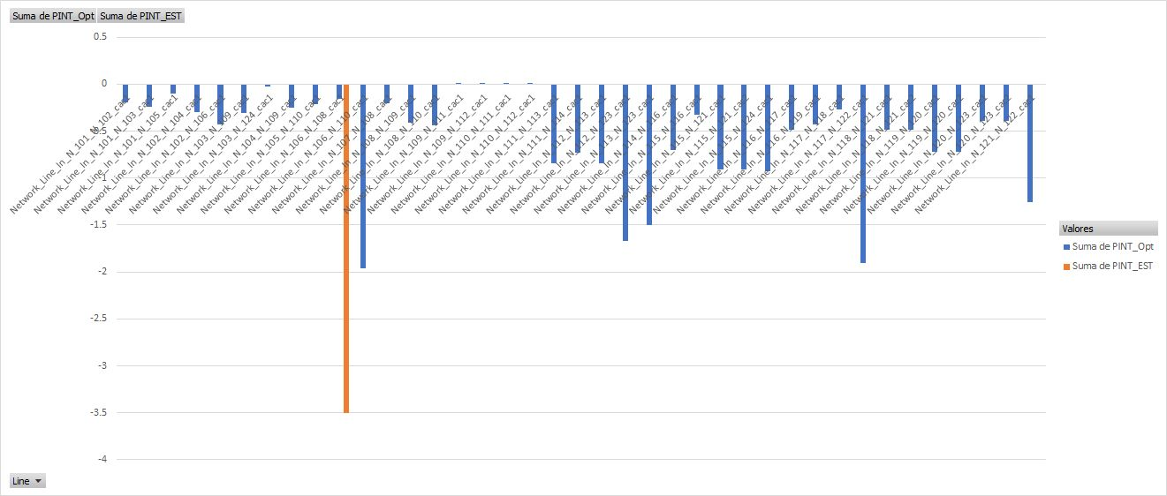
Line Benefits: Preliminary results

Slide 9
